Slide 1
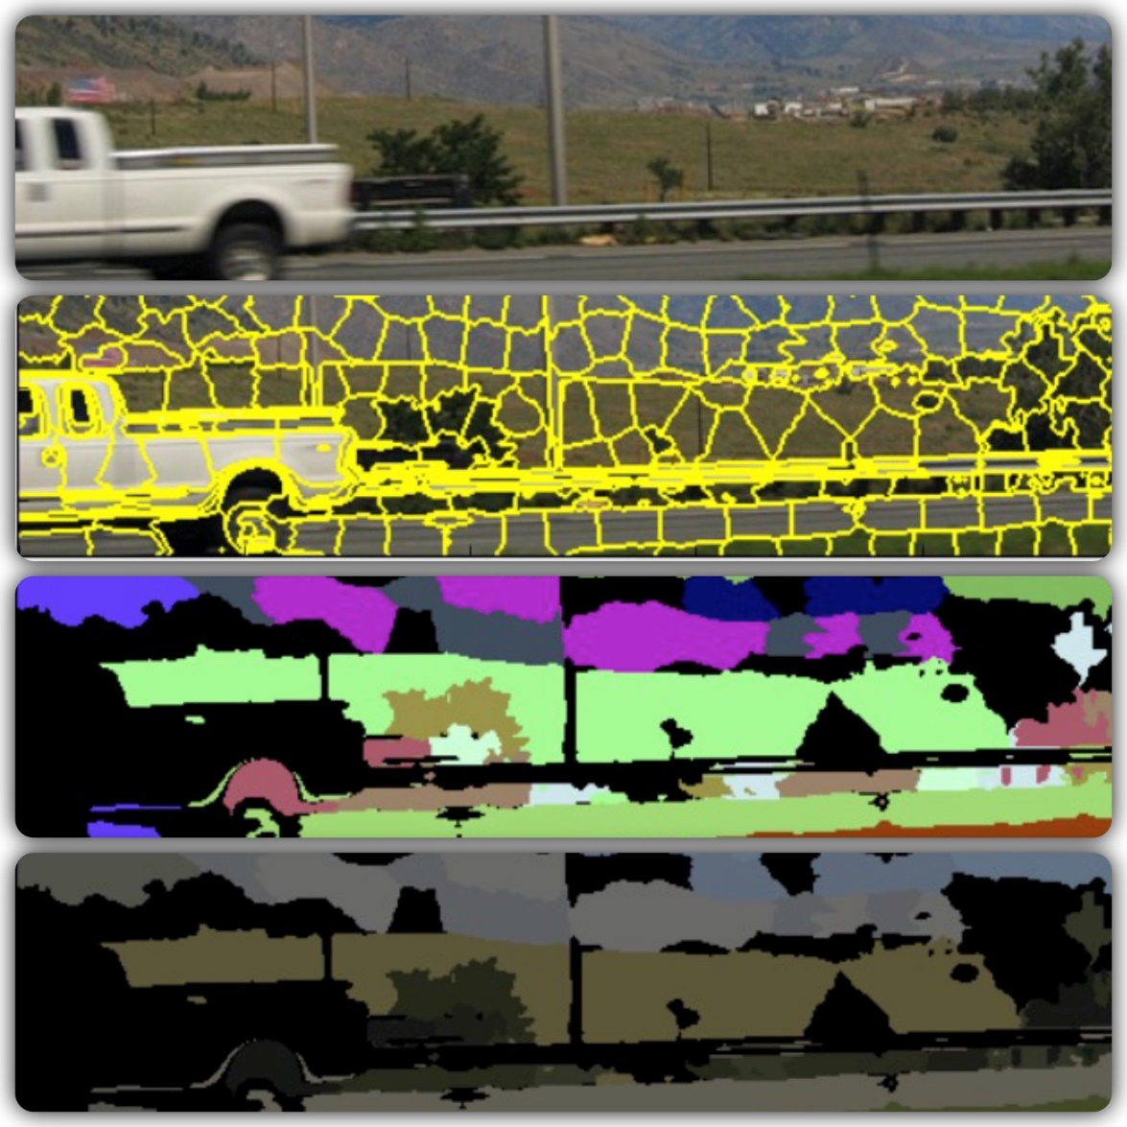

Image Classifier
Pixel Dawgs
NICK ROSETTI
VEERA KARRI
MANISH BORSE
SHREYA GUPTA

Slide 2
Overview
Introduction
Data Acquisition and Data Engineering
Image Processing
SLIC
DBSCAN
GUI
Machine Learning
Supervised learning using SVM
Results
Limitations
Conclusion and Future Work
Poster

Slide 3
Introduction
What is an Image Classifier?
A tool that will identify the content in an image
What can we achieve from that?
Categorization of images
Simple and fast searching of specific tags
Teaching AI to “see”

Slide 4
Data Acquisition and Data Engineering
Open source raw data is provided by Yahoo-Flickr
Image URL (10 files, 5GB each)
File contains image ID and the associated url to download the file
~300,000 images were downloaded
Small subset was used due to computational limitation
Auto-tags (14GB)
File contains image ID and associated auto-tags
File is divided into two separate files
Tags are then associated with a list of image IDs

Slide 5
Image Processing
Must identify “taggable” regions in each image
Otherwise incorrect data will be tagged
Segmentation
Split the image into quantifiable regions
Manual Tagging
Very difficult to algorithmically infer tags for each section of the image based on the training set
Feature Vector Generation
Create a feature vector from a tagged cluster for every tagged image

Slide 6
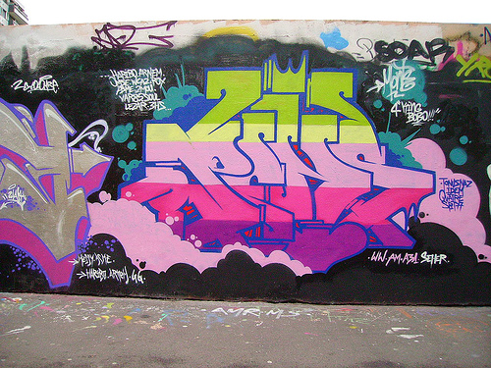
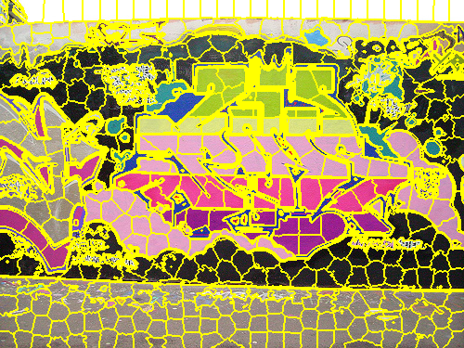
Segmentation - SLIC
Simple Linear Iterative Clustering (SLIC)
Groups pixels in an image into “superpixels”
Helps to easily quantify groups of similar pixels
4-D vector superpixel quantification
Create a 4-D vector for each superpixel which contains mean values for each color channel and mean edge response

Slide 7
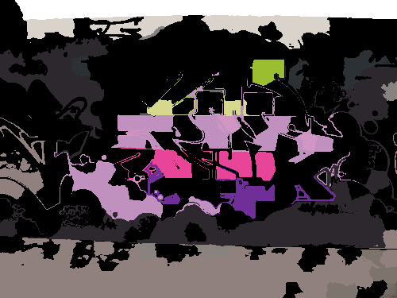
Segmentation - DBSCAN
Density-based spatial clustering of applications with noise (DBSCAN)
Clusters data points based on density
Only clusters superpixels that are “similar enough” and throws away others
Used to generate unique layers in each image

Slide 8
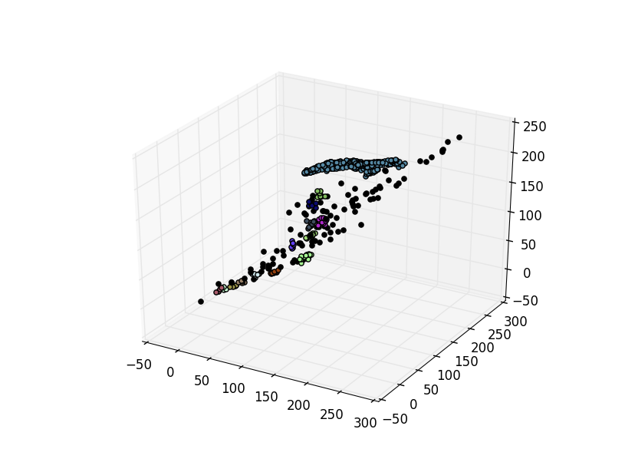
Segmentation - DBSCAN
Graph of DBSCAN clustering results using Lab color channels

Slide 9
Manual Tagging
Tagging GUI
Used for manual tagging of ~900 images to build a training set
Associates a point in an image with a tag
Code later associates the point with a layer

Slide 10
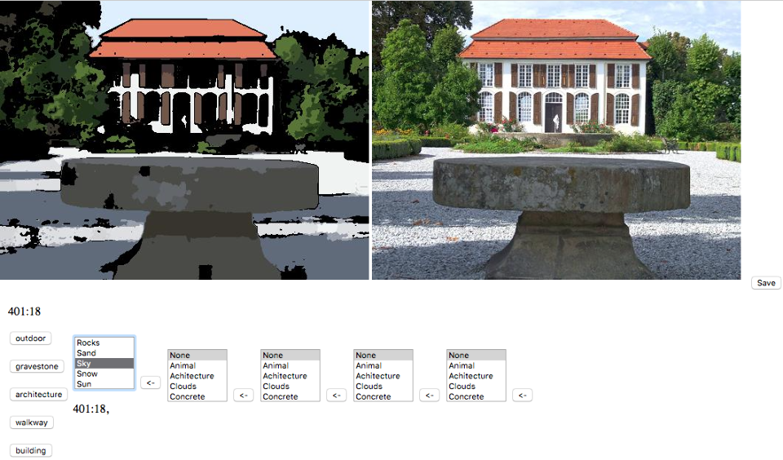
Manual Tagging

Slide 11
Feature Vector Training
Feature Vector Generation
Every segment is represented by a 6-D vector which contains median and standard deviation values for each color channel
Why not PCA or an alternative method?
Simplicity and poor initial performance
All segments associated with all tags have individual feature vectors

Slide 12
Feature Vector Example
"lights": 1: [58.0, 24.0, 3.0, 35.24, 18.07, 5.45],
2: [253.0, 254.0, 251.0, 2.86, 3.22, 23.80]…

Slide 13
Machine Learning – Supervised Learning Using SVM
Background and key terms involved:
We used Support Vector Machines (SVMs)
It is a powerful machine learning technique used for classification
Makes use of feature vectors
These feature vectors describe the categories of classification. For example, the tag “sky” will have a set of feature vectors associated with it.

Slide 14
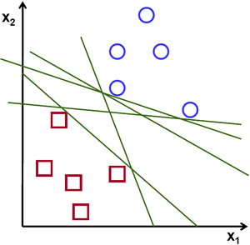
How Support Vector Machines Work
Consider the figure on the right. It represents
A set of 2-D feature vectors represented as a plot.
In this case, the SVM tries to find
a distinguishing line between the 2 types of
objects to be classified. This line is called a
hyperplane.
Similarly, for N dimension feature vectors,
the equivalent of this “line” is an N-1 dimension
hyperplane which separates the data points. So based on which side
of the hyperplane the new data lies on, the SVM
predicts which class/category it belongs to.

Slide 15
Machine Learning Process
Classification based on feature vectors generated from image processing
6-D feature vectors associated with an image tag, e.g. “sky”
Model is fit to the labelled feature vectors (hyperplanes used to create model)

Slide 16
Tagging New Images
A new image is processed by the segmentation algorithm with segments as the output
Every segment is then fit to the model
A tag and probability are output for each segment
Same tags that pass a threshold of 20% probability are averaged and sorted.
A maximum of the top 5 tags is output.

Slide 17
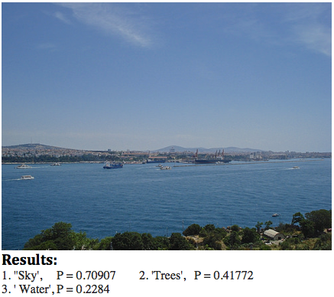
Results
The image on the right shows the top
3 tags generated by the classifier. It
detected ‘sky’ with a probability of
70.9%, ‘trees’ with a probability of
41.7%, and ‘water’ with a probability
of 22.8%. The classifier predicted the
main segments of the image
successfully.

Slide 18
Limitations of the Classifier
Very limited in what kinds of things it can detect. Most of our training data consisted of outdoor images, so the classifier detects people, sky, water, grass, trees, etc. better than other things
Since the training set was small, the classification is limited, and the accuracy is low
Similarly colored objects can be erroneously tagged because the algorithm is almost purely color based

Slide 19
Conclusion and Future Work
Biggest conclusion – image classification is very difficult
Even with extensive libraries available, a lot of work must be done to create an accurate classifier
Image segmentation needs to be tuned separately for training and classification.
Better feature vectors must be formed by using other indicators such as shape, global inference, and feature association.
With better quantification of segments in the image a more accurate classifier can be created.

Slide 20
Contributions
Nick Rosetti – 33 commits
Image Processing
Machine Learning Integration/Research
End-to-end design
Veera Karri – 8 commits
Data Acquisition
UI Design
Poster Design
Manish Borse - 23 commits
Documentation
Machine Learning Research
Shreya Gupta – 22 commits
Machine Learning Implementation/Research

Slide 21
